Slide 1

Module 7.2 – Parallel Computation Patterns (Histogram)
Introduction to Data Races

Slide 2
Objective
To understand data races in parallel computing
Data races can occur when performing read-modify-write operations
Data races can cause errors that are hard to reproduce
Atomic operations are designed to eliminate such data races

Slide 3
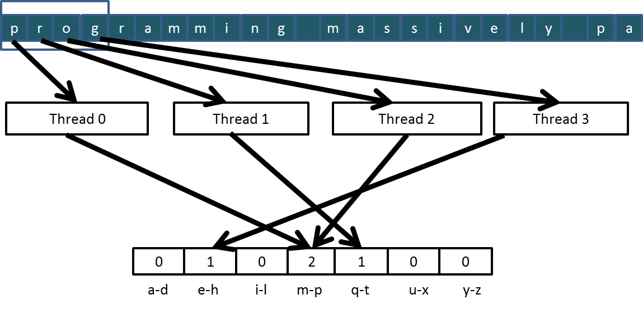
Read-modify-write in the Text Histogram Example
For coalescing and better memory access performance
…

Slide 4
Read-Modify-Write Used in Collaboration Patterns
For example, multiple bank tellers count the total amount of cash in the safe
Each grab a pile and count
Have a central display of the running total
Whenever someone finishes counting a pile, read the current running total (read) and add the subtotal of the pile to the running total (modify-write)
A bad outcome
Some of the piles were not accounted for in the final total

Slide 5
A Common Parallel Service Pattern
For example, multiple customer service agents serving waiting customers
The system maintains two numbers,
the number to be given to the next incoming customer (I)
the number for the customer to be served next (S)
The system gives each incoming customer a number (read I) and increments the number to be given to the next customer by 1 (modify-write I)
A central display shows the number for the customer to be served next
When an agent becomes available, he/she calls the number (read S) and increments the display number by 1 (modify-write S)
Bad outcomes
Multiple customers receive the same number, only one of them receives service
Multiple agents serve the same number

Slide 6
A Common Arbitration Pattern
For example, multiple customers booking airline tickets in parallel
Each
Brings up a flight seat map (read)
Decides on a seat
Updates the seat map and marks the selected seat as taken (modify-write)
A bad outcome
Multiple passengers ended up booking the same seat

Slide 7
Data Race in Parallel Thread Execution
thread1:
Old ← Mem[x]
New ← Old + 1
Mem[x] ← New
thread2:
Old ← Mem[x]
New ← Old + 1
Mem[x] ← New
Old and New are per-thread register variables.
Question 1: If Mem[x] was initially 0, what would the value of Mem[x] be after threads 1 and 2 have completed?
Question 2: What does each thread get in their Old variable?
Unfortunately, the answers may vary according to the relative execution timing between the two threads, which is referred to as a data race.

Slide 8
Timing Scenario #1
Time | Thread 1 | Thread 2
1 | (0) Old ← Mem[x]
2 | (1) New ← Old + 1
3 | (1) Mem[x] ← New
4 |  | (1) Old ← Mem[x]
5 |  | (2) New ← Old + 1
6 |  | (2) Mem[x] ← New
Thread 1 Old = 0
Thread 2 Old = 1
Mem[x] = 2 after the sequence

Slide 9
Timing Scenario #2
Time | Thread 1 | Thread 2
1 |  | (0) Old ← Mem[x]
2 |  | (1) New ← Old + 1
3 |  | (1) Mem[x] ← New
4 | (1) Old ← Mem[x]
5 | (2) New ← Old + 1
6 | (2) Mem[x] ← New
Thread 1 Old = 1
Thread 2 Old = 0
Mem[x] = 2 after the sequence

Slide 10
Timing Scenario #3
Time | Thread 1 | Thread 2
1 | (0) Old ← Mem[x]
2 | (1) New ← Old + 1
3 |  | (0) Old ← Mem[x]
4 | (1) Mem[x] ← New
5 |  | (1) New ← Old + 1
6 |  | (1) Mem[x] ← New
Thread 1 Old = 0
Thread 2 Old = 0
Mem[x] = 1 after the sequence

Slide 11
Timing Scenario #4
Time | Thread 1 | Thread 2
1 |  | (0) Old ← Mem[x]
2 |  | (1) New ← Old + 1
3 | (0) Old ← Mem[x]
4 |  | (1) Mem[x] ← New
5 | (1) New ← Old + 1
6 | (1) Mem[x] ← New
Thread 1 Old = 0
Thread 2 Old = 0
Mem[x] = 1 after the sequence

Slide 12
Purpose of Atomic Operations – To Ensure Good Outcomes
thread1:
Old ← Mem[x]
New ← Old + 1
Mem[x] ← New
thread2:
Old ← Mem[x]
New ← Old + 1
Mem[x] ← New
Or
thread2:
Old ← Mem[x]
New ← Old + 1
Mem[x] ← New
thread1:
Old ← Mem[x]
New ← Old + 1
Mem[x] ← New

Slide 13
The GPU Teaching Kit is licensed by NVIDIA and the University of Illinois under the Creative Commons Attribution-NonCommercial 4.0 International License.

